Slide 1
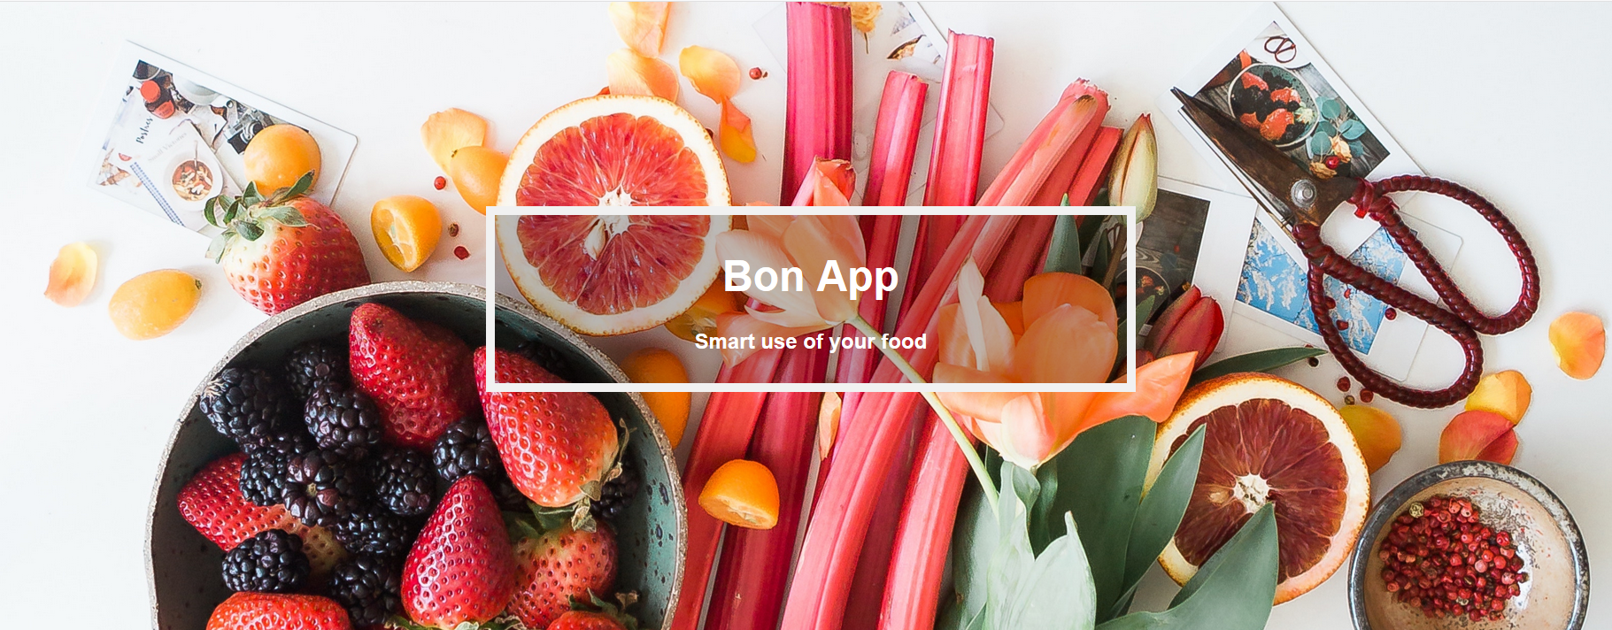

Slide 2
Table of Content
Use Cases
Live Demo
Challanges
Technically

Slide 3

Use Cases
As a hungry monster I want a recipe, based on ingredients I have at home and filter them by personal preferences.
As a hungry monster I want a shopping-list of the ingredients I have to buy, based on the recipe I choose.
As a lazy monster I want to scan my bill to add my shoping to the stock list.

Slide 4
Live Demo

Slide 5
Challenges

Slide 6
Technically

Slide 7
Question?

